Slide 1
Las Palmas, Spain
Geo 542
David Cardenas Ochoa

Slide 2
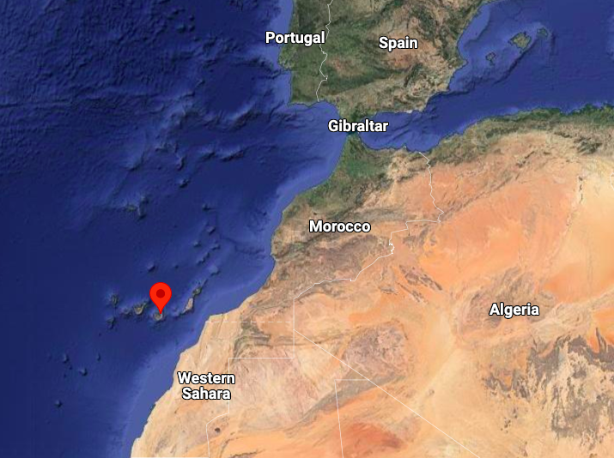
Global View

Slide 3
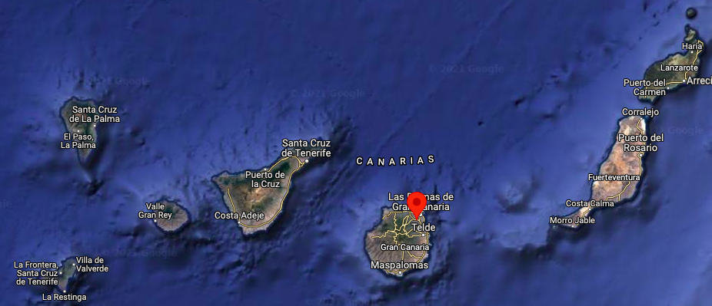
Global View

Slide 4
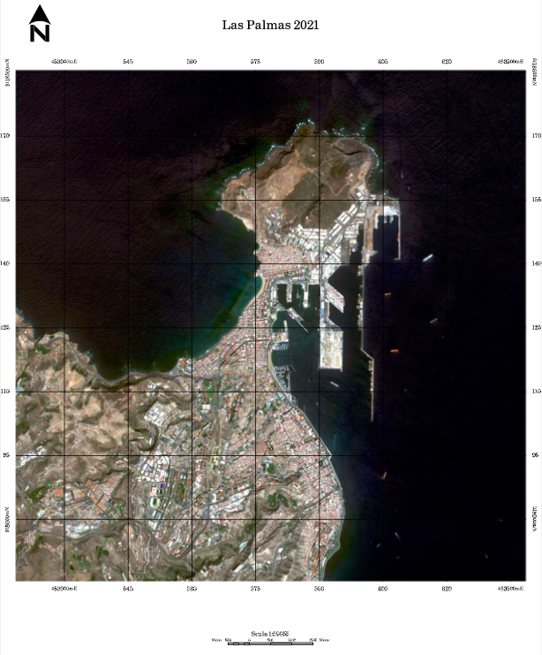
Natural Map

Slide 5
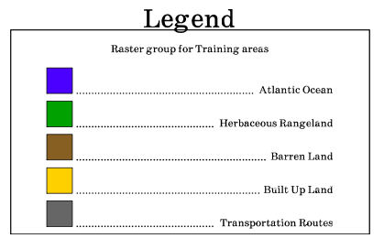
Chosen Classifications

Slide 6
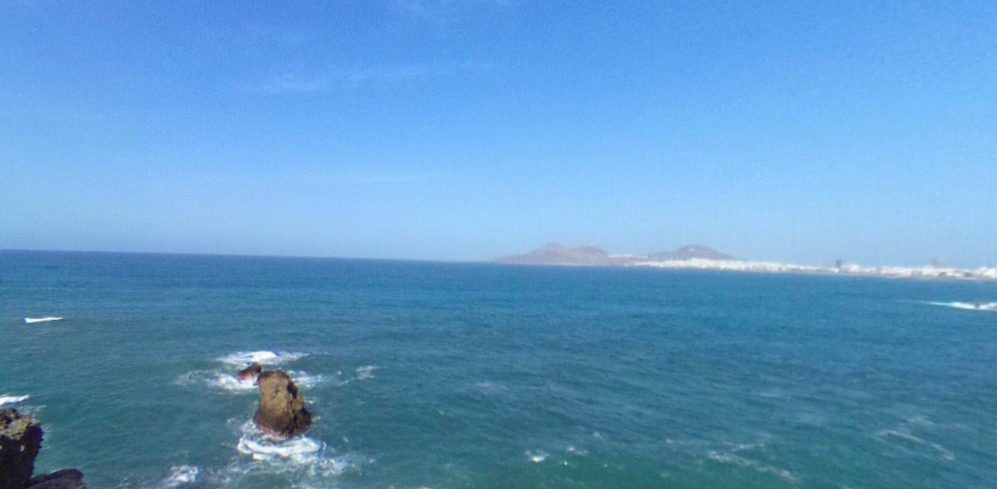
Atlantic Ocean

Slide 7
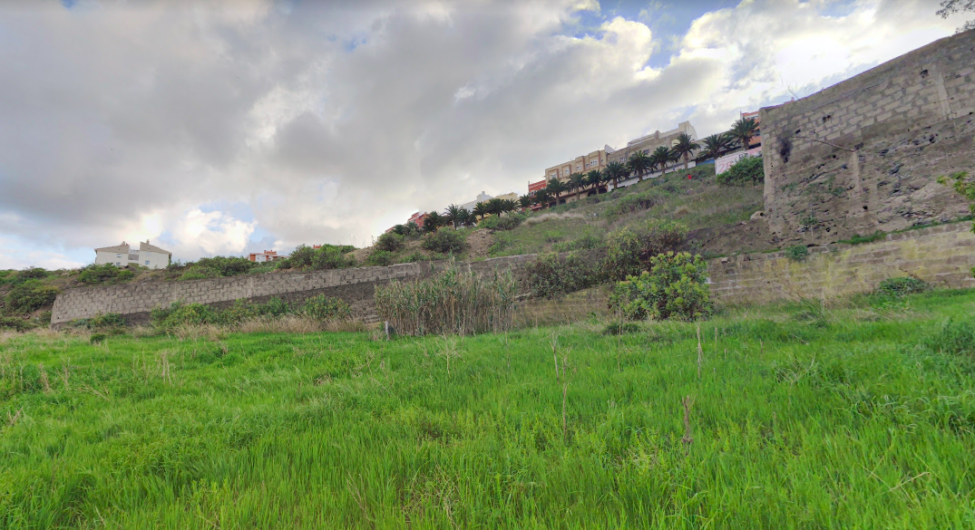
Herbaceous Rangeland

Slide 8
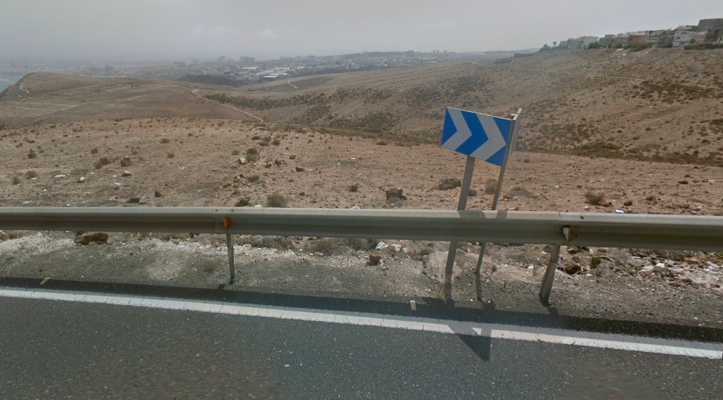
Barren Land

Slide 9
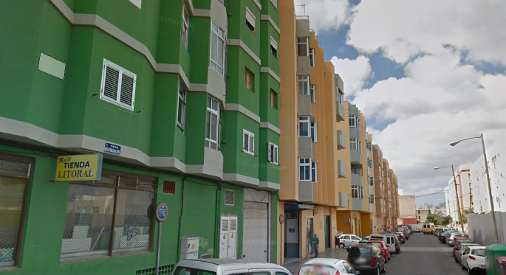
Built Up Land

Slide 10
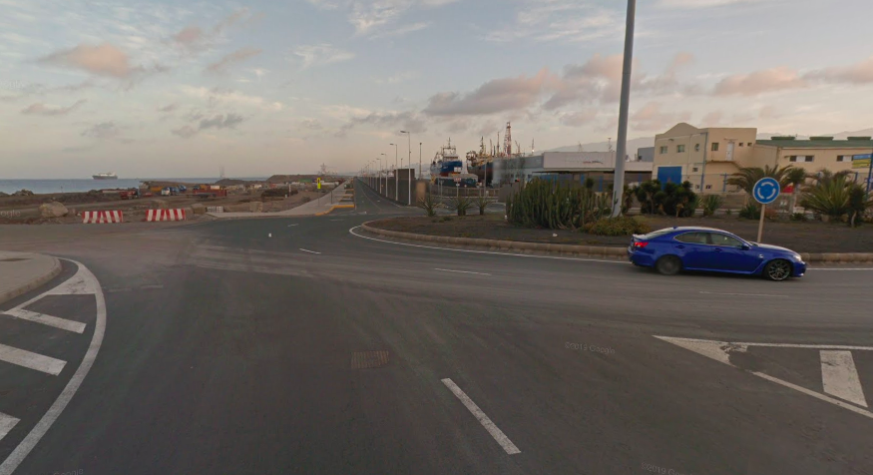
Transportation Routes

Slide 11
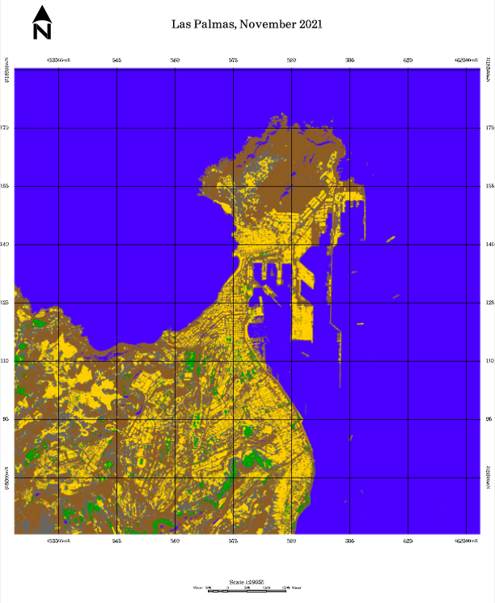
Unsupervised Map

Slide 12
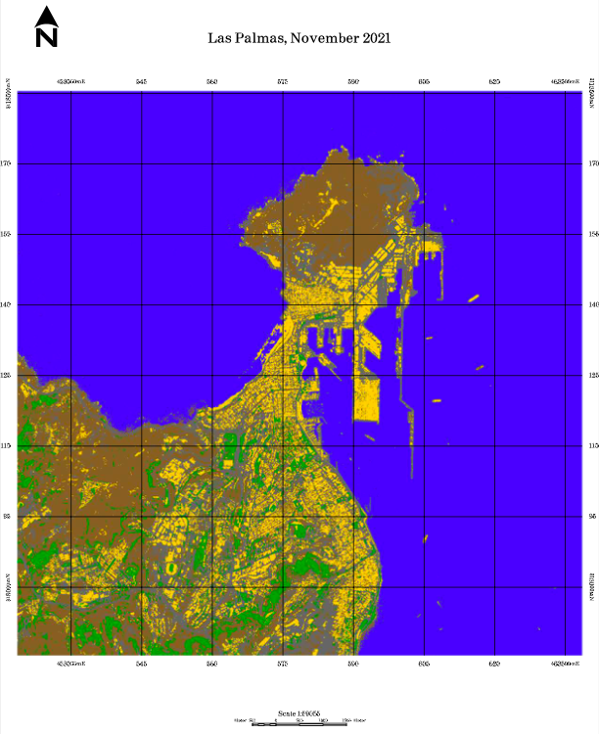
Supervised Map

Slide 13
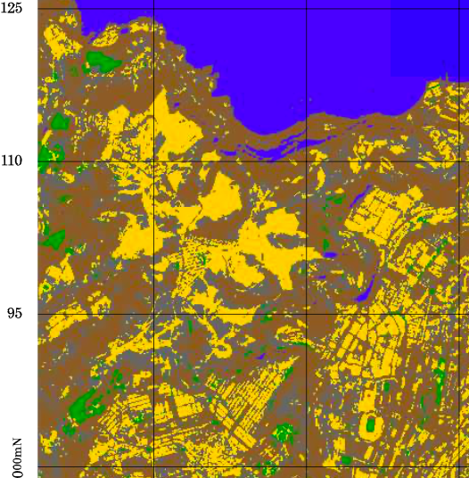
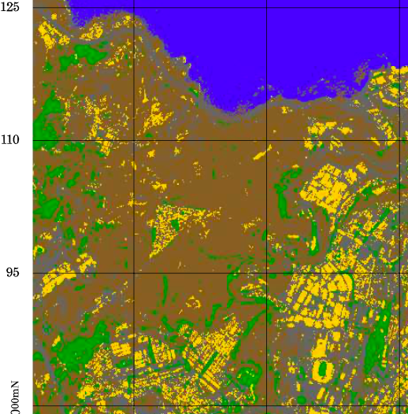
Unsupervised Vs Supervised

Slide 14
Thank you for your attention!
References: Google Maps

